Slide 1

Introduction to Git - Part 2
A Distributed Version Control System

Slide 2
Things we will cover
Brief about Git GUI
Why we need remote repositories
Setting up our Github Access Credentials
Git push and Git pull
How to write Markdown to make our Github repo look better

Slide 3
Brief Recap

Slide 4
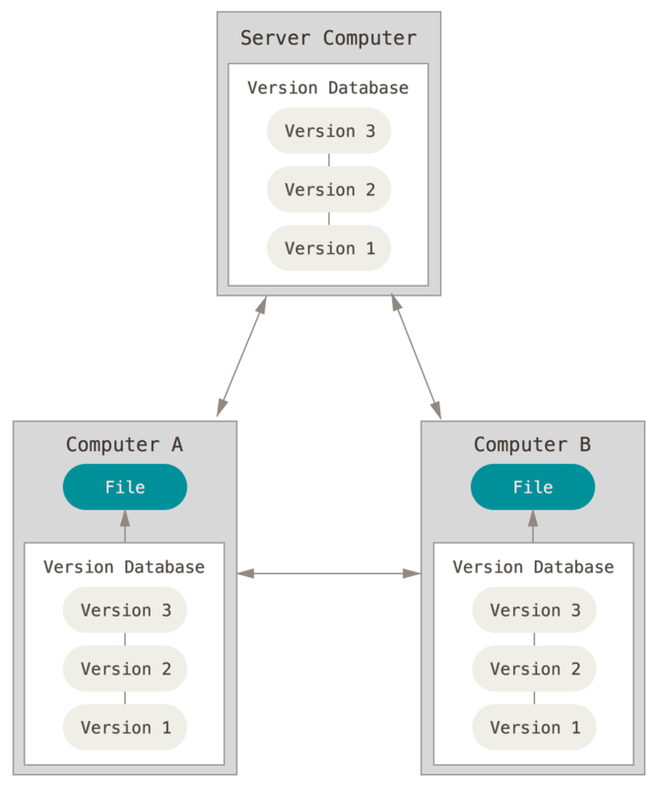
Distributed Version Control Systems
Notes:
This is where Distributed Version Control Systems (DVCSs) step in. In a DVCS (such as Git, Mercurial, Bazaar or Darcs), clients don’t just check out the latest snapshot of the files; rather, they fully mirror the repository, including its full history. Thus, if any server dies, and these systems were collaborating via that server, any of the client repositories can be copied back up to the server to restore it. Every clone is really a full backup of all the data.
Furthermore, many of these systems deal pretty well with having several remote repositories they can work with, so you can collaborate with different groups of people in different ways simultaneously within the same project. This allows you to set up several types of workflows that aren’t possible in centralized systems, such as hierarchical models.

Slide 5
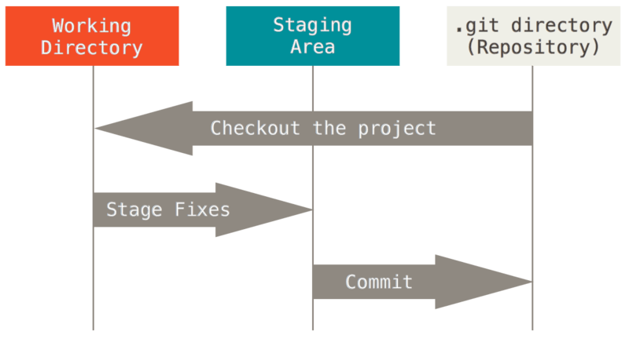
The Three Stages
Notes:
Pay attention now — here is the main thing to remember about Git if you want the rest of your learning process to go smoothly.
Git has three main states that your files can reside in: modified, staged, and committed:
Modified means that you have changed the file but have not committed it to your database yet.
Staged means that you have marked a modified file in its current version to go into your next commit snapshot.
Committed means that the data is safely stored in your local database.
This leads us to the three main sections of a Git project: the working tree, the staging area, and the Git directory.

Slide 6
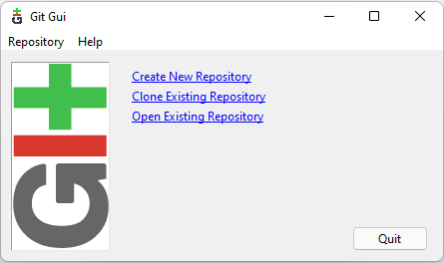
A bit about Git GUI
Notes:
Most operations in Git need only local files and resources to operate — generally no information is needed from another computer on your network.
Everything in Git is checksummed before it is stored and is then referred to by that checksum. This means it’s impossible to change the contents of any file or directory without Git knowing about it. This functionality is built into Git at the lowest levels and is integral to its philosophy. You can’t lose information in transit or get file corruption without Git being able to detect it.
When you do actions in Git, nearly all of them only add data to the Git database. It is hard to get the system to do anything that is not undoable or to make it erase data in any way.

Slide 7
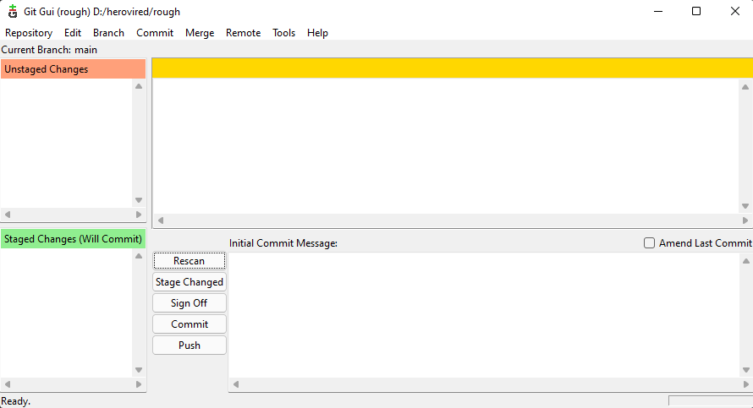
A bit about Git GUI
Notes:
Most operations in Git need only local files and resources to operate — generally no information is needed from another computer on your network.
Everything in Git is checksummed before it is stored and is then referred to by that checksum. This means it’s impossible to change the contents of any file or directory without Git knowing about it. This functionality is built into Git at the lowest levels and is integral to its philosophy. You can’t lose information in transit or get file corruption without Git being able to detect it.
When you do actions in Git, nearly all of them only add data to the Git database. It is hard to get the system to do anything that is not undoable or to make it erase data in any way.

Slide 8
Why we need remote repositories
Everything local has a single point of failiure
Laptop/PC damaged
Collaboration
Notes:
Most operations in Git need only local files and resources to operate — generally no information is needed from another computer on your network.
Everything in Git is checksummed before it is stored and is then referred to by that checksum. This means it’s impossible to change the contents of any file or directory without Git knowing about it. This functionality is built into Git at the lowest levels and is integral to its philosophy. You can’t lose information in transit or get file corruption without Git being able to detect it.
When you do actions in Git, nearly all of them only add data to the Git database. It is hard to get the system to do anything that is not undoable or to make it erase data in any way.

Slide 9
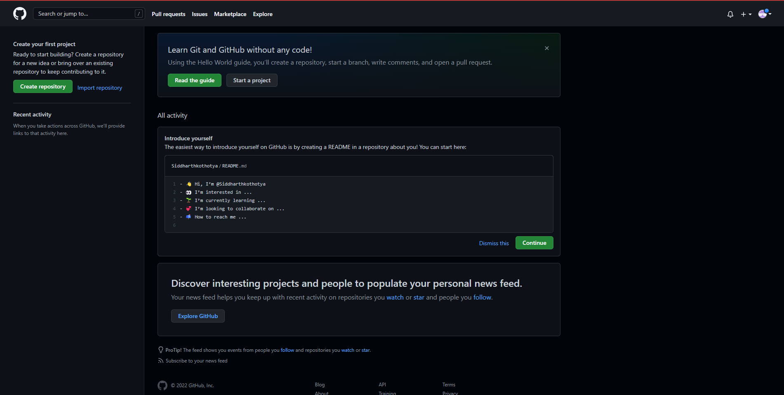
Setting up Github
Notes:
Most operations in Git need only local files and resources to operate — generally no information is needed from another computer on your network.
Everything in Git is checksummed before it is stored and is then referred to by that checksum. This means it’s impossible to change the contents of any file or directory without Git knowing about it. This functionality is built into Git at the lowest levels and is integral to its philosophy. You can’t lose information in transit or get file corruption without Git being able to detect it.
When you do actions in Git, nearly all of them only add data to the Git database. It is hard to get the system to do anything that is not undoable or to make it erase data in any way.

Slide 10
Setting up our Github Access Credentials
The link that github gives to setup access keys
https://docs.github.com/en/authentication/connecting-to-github-with-ssh/generating-a-new-ssh-key-and-adding-it-to-the-ssh-agent
Notes:
Most operations in Git need only local files and resources to operate — generally no information is needed from another computer on your network.
Everything in Git is checksummed before it is stored and is then referred to by that checksum. This means it’s impossible to change the contents of any file or directory without Git knowing about it. This functionality is built into Git at the lowest levels and is integral to its philosophy. You can’t lose information in transit or get file corruption without Git being able to detect it.
When you do actions in Git, nearly all of them only add data to the Git database. It is hard to get the system to do anything that is not undoable or to make it erase data in any way.

Slide 11
Let’s do a git push and git pull
I’ll push the example directory from my system
And You can pull the directory from github to your system
To push
git remote add origin “youraddresshere”
git remote –v
git push remote branch_name / git push origin main
To pull
git pull “yourlinkhere”
Notes:
Most operations in Git need only local files and resources to operate — generally no information is needed from another computer on your network.
Everything in Git is checksummed before it is stored and is then referred to by that checksum. This means it’s impossible to change the contents of any file or directory without Git knowing about it. This functionality is built into Git at the lowest levels and is integral to its philosophy. You can’t lose information in transit or get file corruption without Git being able to detect it.
When you do actions in Git, nearly all of them only add data to the Git database. It is hard to get the system to do anything that is not undoable or to make it erase data in any way.

Slide 12
Let’s Recap

Slide 13
What and why markdown ?

Slide 14
Without Markdown
You don’t know what the project is about
No one will go through all of your code to see what the project is about
You need to make sure to explain what your project is, what are it’s features and uses, what technology it uses, what are the limitations.
Notes:
Most operations in Git need only local files and resources to operate — generally no information is needed from another computer on your network.
Everything in Git is checksummed before it is stored and is then referred to by that checksum. This means it’s impossible to change the contents of any file or directory without Git knowing about it. This functionality is built into Git at the lowest levels and is integral to its philosophy. You can’t lose information in transit or get file corruption without Git being able to detect it.
When you do actions in Git, nearly all of them only add data to the Git database. It is hard to get the system to do anything that is not undoable or to make it erase data in any way.

Slide 15
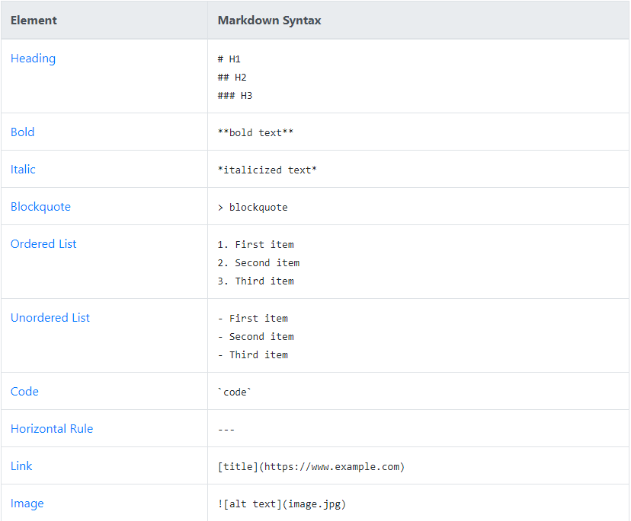
Let’s write some Markdown
Notes:
Most operations in Git need only local files and resources to operate — generally no information is needed from another computer on your network.
Everything in Git is checksummed before it is stored and is then referred to by that checksum. This means it’s impossible to change the contents of any file or directory without Git knowing about it. This functionality is built into Git at the lowest levels and is integral to its philosophy. You can’t lose information in transit or get file corruption without Git being able to detect it.
When you do actions in Git, nearly all of them only add data to the Git database. It is hard to get the system to do anything that is not undoable or to make it erase data in any way.

Slide 16
Thank You

